Slide 1



CSE310
Programming in Java
Lecture #0
The kick start session

Slide 2
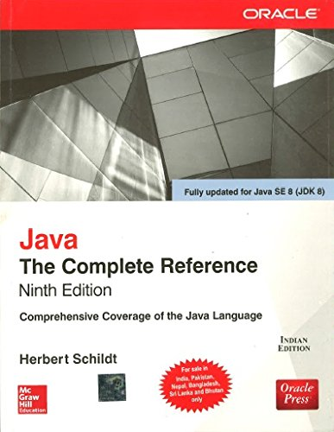
Course details
LTP – 3 0 2 [Five hours/week]
Credit – 4
Text Book
  Introduction to java programming by
  Y. DANIEL LIANG, Pearson
  Reference Book
  Java: The Complete Reference by
  Herbert Schildt, Mcgraw Hill Education

Slide 3
Course details – other resources
Updated and authentic documentation of latest features is available - https://docs.oracle.com/javase/8/
Video lectures on basics constructs of Java Programming - http://freevideolectures.com/Course/2513/Java-Programming

Slide 4

Course Outcomes
Through this course students should be able to
Describe basic constructs of Java programming and apply them to solve the real-world problems.
Illustrate the Object-oriented programming principles to write efficient and reusable codes.
Examine the concept of inheritance to reuse and extend the features of existing class with access
control.
Discuss the applications of abstract classes, interfaces and Lambda expressions.
Construct robust java applications to handle environment specific issues at run-time.
Assess predefined java libraries and in-built data structures to use them for developing efficient java applications.

Slide 5
Program Outcomes specific to the course
Apply basic knowledge in the areas such as Software Engineering, Networking amp Security, Database Management Systems, Intelligent Systems, Operating Systems and System Architecture for building Software products.
Attain the ability to design and develop software based systems, evaluate and recognize potential risks and provide creative, economical and optimal solutions.
Provide effective and efficient real time solutions using attained knowledge in inter-disciplinary domains for societal benefits through projects.
Ability to adapt future technologies through acquired skills and knowledge to ideate, design, test and deploy solutions for different business environments.

Slide 6
Course Assessment Model
Marks break up*
Attendance 5
CA (Daily Practice Problems, Project, and CBT) 50
MTE -
ETE 45
Total 100

Slide 7
Course Assessment Model..
* Course Assessment:
Daily Practice problems including code based questions and MCQ. [15]
One best out of two Code Based Tests. [20]
One compulsory project (to be performed in group of three students). [15]

Slide 8
Course Assessment Model..
Daily practice problems will include code based questions and multiple choice questions.
  2 code based questions will be asked daily on hackerrank (between 7 pm to 1pm next day).
  5 MCQs will be asked on OAS platform every Saturday, with link being active for 1 hour.
  Daily practice problems will be asked from week 2 to week 12 (for 10 weeks, with no problems in MTE week).
  Total 100 code based questions and 50 MCQs will be asked in 10 weeks.
  Random 10 contests and 5 MCQ tests will be considered in final evaluation.

Slide 9
Course Assessment Model..
Two CBTs will be held.
  1 best will be considered.
  Each CBT(30 marks) will be broken into MCQs(10 marks) and a coding problem (20 marks).
Project evaluation is to be conducted in 12th week (30 marks).
  Rubrics for project evaluation–
    progress till MTE (5 marks),
    group presentation(5 marks),
    viva(10 marks),
    Innovativeness(5 marks),
    and project report(5 marks).
ETE exam shall include multiple choice questions.

Slide 10

Some Programming Tips......
“Some of the best programming is done on paper, really. Putting it into the computer is just a minor detail. “
“First, solve the problem. Then, write the code.”
So Let’s Gear up for challenge
ahead.............

Slide 11

Get Certified to Stand Out in a Crowd
Expand your knowledge base and validate your skills to appeal to potential employers.
Improve your potential earning power to command a higher salary.
Learn to perform complex, hands-on activities through lab, study and practice sessions.
Access a secure digital badge you can add to your social media profiles.
Gain exposure to a wide variety of important features, functions and tasks to use on the job.

Slide 12
Get Certified to Stand Out in a Crowd
MOOC: https://nptel.ac.in/courses/106105191
(Course enrollment till 30th Jan 2023)
On the completion of the course and qualifying the proctored exam, all the CAs will be exempted (exam scheduled on 30th April by NPTEL).
Certification: https://education.oracle.com/java-se-8-programmer-i/pexam_1Z0-808
On qualifying the OCAJP 1Z0-808 certification exam, complete Course of CSE310 will be exempted.

Slide 13
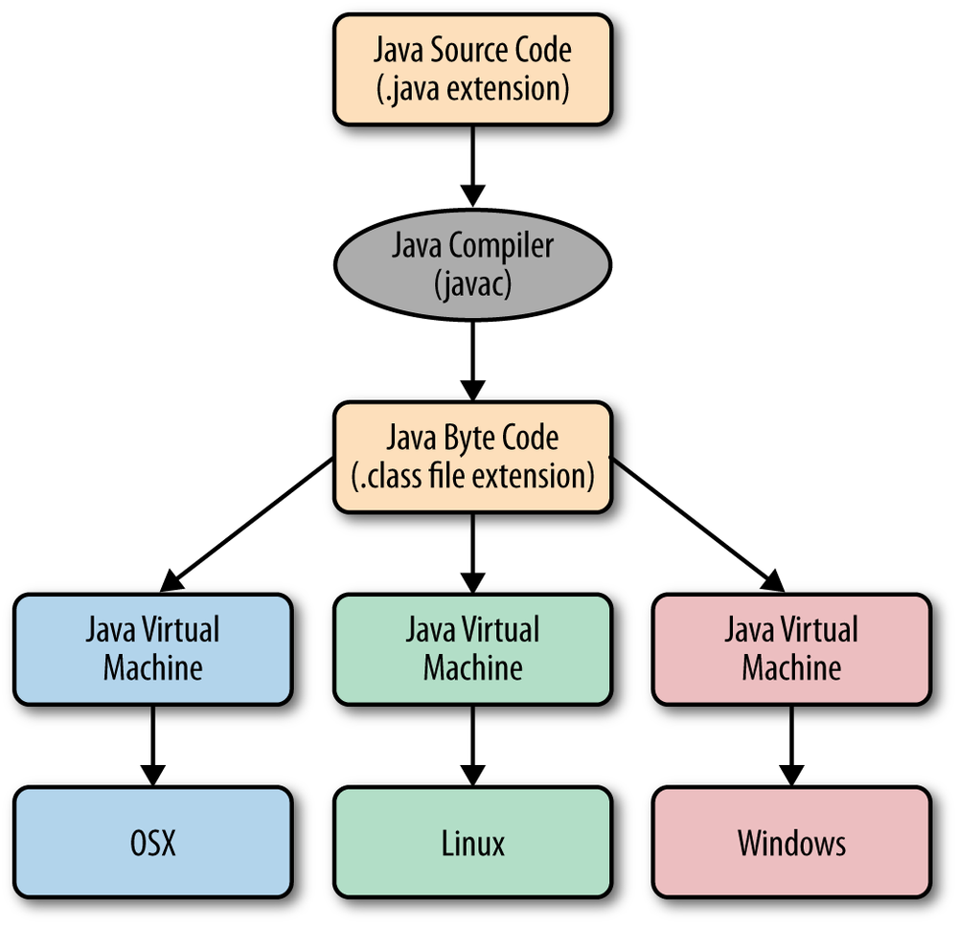
Division of course
Syllabus is divided into a total of 6 units:
Unit I-
  Introduction to Java : History and Features of Java, Java program structure, Writing simple Java class and main() method, Command-line arguments, Understanding JDK, JRE and JVM
  Data In the Cart : Using primitive data types, Type conversion, Keywords, Identifiers, Variables, Access modifiers, static keyword, Wrapper class
  Operators : Working with Bit-wise, arithmetic, logical, and relational operators, Unary, assignment and Ternary operator, Operator precedence Conditional Statements : Using if/else constructs and switch-case statements.

Slide 14
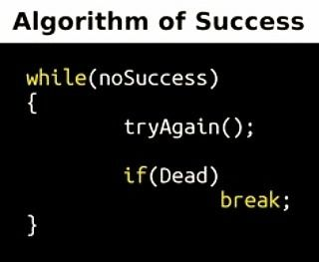
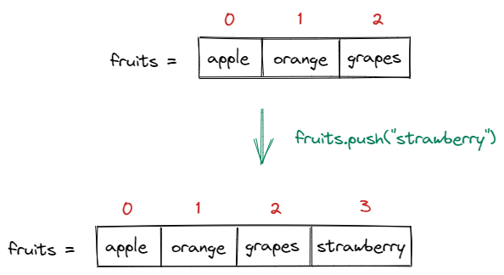
Division of course
Unit II-
  Loops : Working with for loop, while loop, do-while loop and for-each loop
  Arrays and Enums : Fundamentals about Arrays, Multi-dimensional arrays, Array Access and Iterations, Using varargs, Enumerations

Slide 15
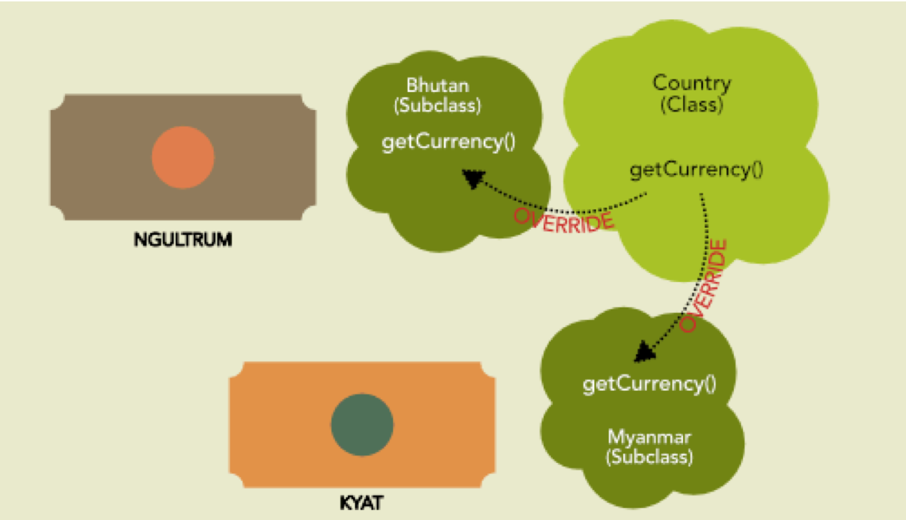
Division of course
Unit II-
  OOP Concepts : Basics of class and objects, Writing constructors and methods, Overloading methods and constructors, this keyword, initializer blocks
  String Class : Constructors and methods of String and String Builder class

Slide 16
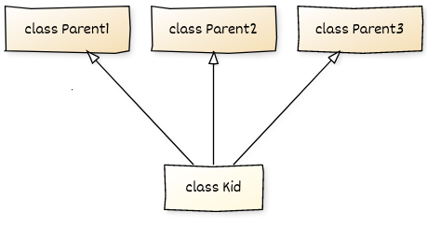

Division of course
Unit III
  Inheritance and Polymorphism : Inheritance, Method overriding, super keyword, Object class and overriding toString() and equals() method, Using super and final keywords, instanceof operator
  Abstract Class and Interface : Abstract method and abstract class, Interfaces, static and default methods, Using Swing Components to demonstrate inheritance

Slide 17

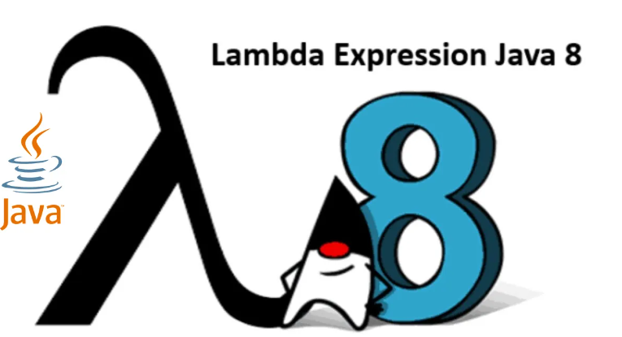
Division of course
Unit IV
  Functional Interface and Lambda Expressions : Using Lambda expressions, Implementing Threads using Lambda expressions, Implementing Listener using Lambda expressions
  Nested Class : Understanding the importance of static and non-static nested classes, Local and Anonymous class
  Utility Classes : Working with Dates
Hi, anonymous

Slide 18
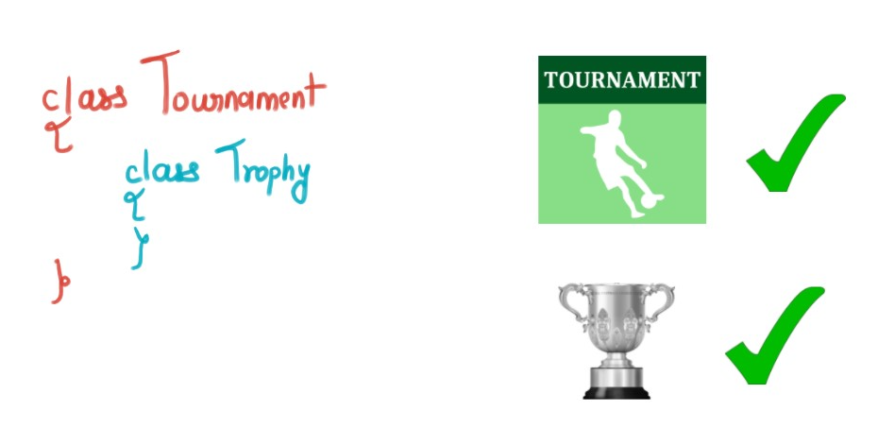
Division of course
Unit IV
  Nested Class : Understanding the importance of static and non-static nested classes, Local and Anonymous class
  Utility Classes : Working with Dates

Slide 19
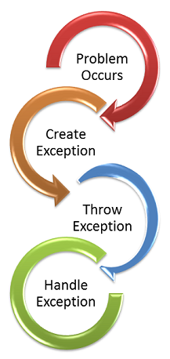
Division of course
Unit V
  Exceptions and Assertions : Exception overview, Exception class hierarchy and exception types, Propagation of exceptions, Using try, catch and finally for exception handling, Usage of throw and throws, handling multiple exceptions using multi-catch, Autoclose resources with try-with resources statement, Creating custom exceptions, Testing invariants by using assertions

Slide 20
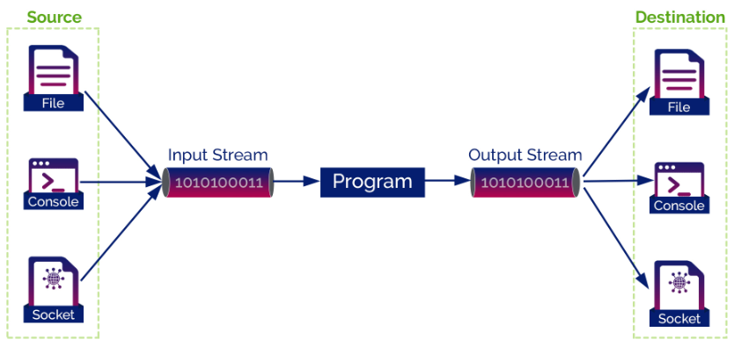
Division of course
Unit V
  I/O Fundamentals : Describing the basics of input and output in Java, Read and write data from the console, Using streams to read and write files, Writing and read objects using serialization

Slide 21
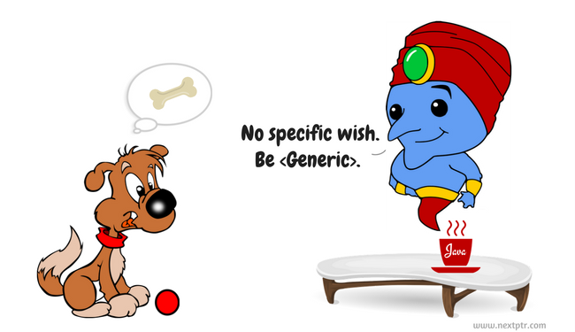
Division of course
Unit VI
  Collections and Generics : Creating a custom generic class, Using the type inference diamond to create an object, Using bounded types and Wild Cards, Creating a collection by using generics, Implementing an ArrayList, Implementing TreeSet using Comparable and Comparator interfaces, Implementing a HashMap, Implementing a Deque

Slide 22
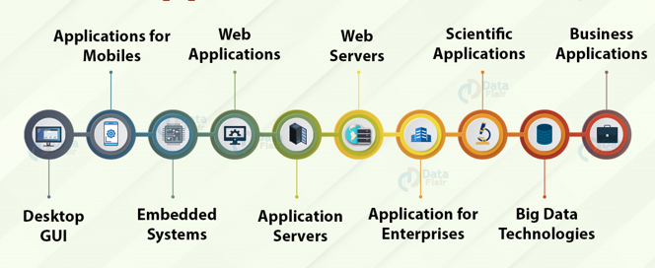
Java Applications
IoT Applications
  IoT programmers gravitate towards Java because of its security, flexibility, and versatility.
  health gears, smartphones, wearables, smart lighting, TVs, etc.
Big Data Technology
  Java is widely used in ETL applications such as Apache Camel and Apache Kafka. It is used to extract and transform data, and load in big data environments.
  tool Hadoop HDFS platform is written in java.
Game Development
  widely used by game development companies.
  most powerful 3D engine.
  Minecraft, Mission Impossible III, etc.
Web-based Applications
  provides vast support for web development through Servlet, JSP, and Struts.
  LinkedIn, AliExpress, web.archive.org, IRCTC, etc.
GUI in Java
  Swing and JavaFX are the most commonly used applications.

Slide 23

Top Companies that Use Java

Slide 24
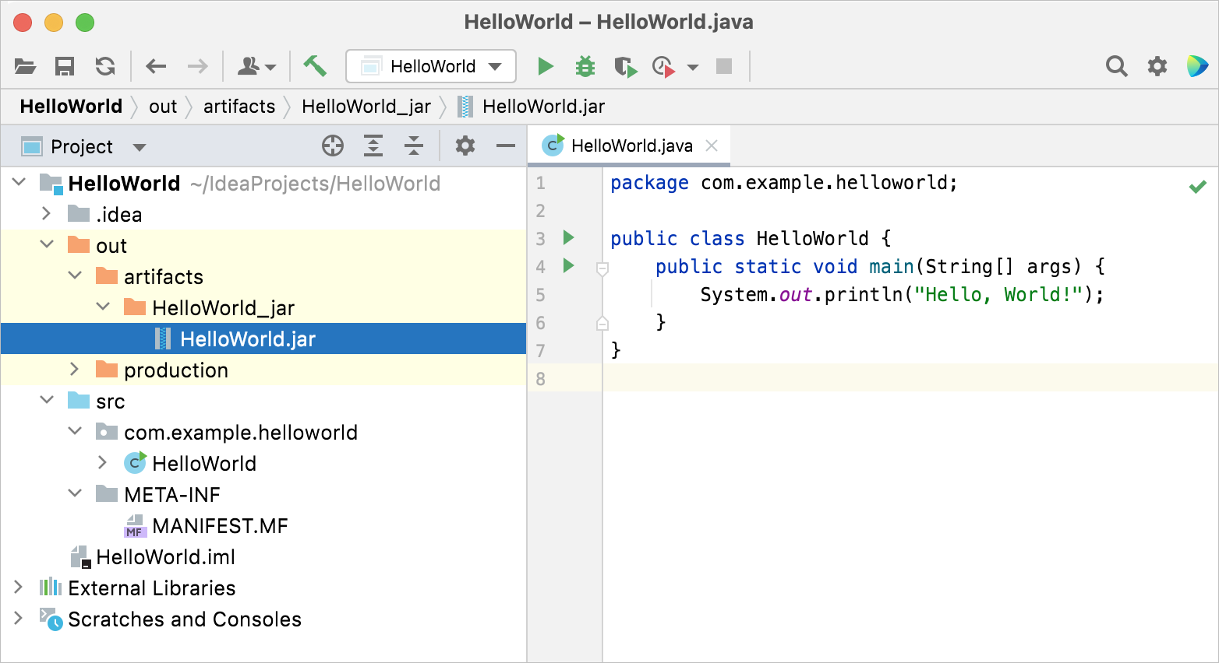
IntelliJ IDEA – the Leading Java IDE - JetBrains
https://www.jetbrains.com/help/idea/creating-and-running-your-first-java-application.html
Notes:
2
54
70

